Slide 1
Validating data analysis through benchmark
A hands-on programming workshop for analyzing public source data
Notes:
Hi all, thank you so much for joining me today for the workshop on validating data analysis through benchmark.
This is a hands-on workshop aimed at providing participants with the knowledge and tools to validate analysis of public microdata using R programming language.
Public use microdata files, such as the Census Current Population Survey, which we will define and talk extensively about, are a crucial resource that allow users to produce custom analyses and insights that published aggregated data cannot offer.

Slide 2

About Me
Jori Kandra
Reproducibility pipelines
Increasing replicability
Building out data programming
Notes:
A little bit about me.
My name is Jori Kandra and I’ve been at EPI for almost 4 years.
I have spent much of my time helping to build out the data programming techniques and capabilities in the general research department and have focused extensively on constructing reproducibility pipelines and increasing the replicability of our work.
I’m really grateful for the opportunity to share my knowledge and experience and excited to be here with our EARN partners today!

Slide 3

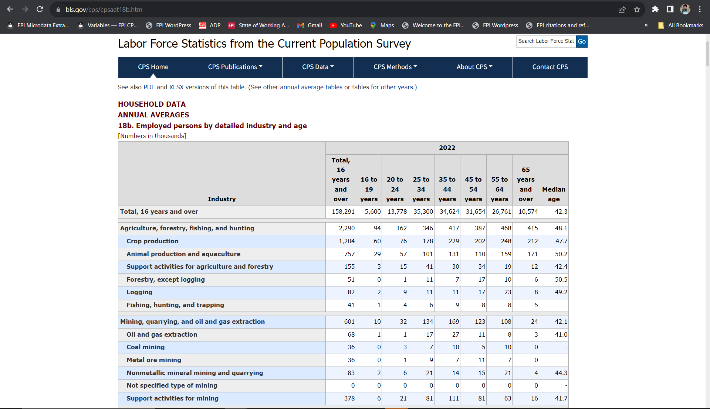

What is benchmarking & data validation?
to
Comparing internal data to externally (or sometimes internally) published sources
Census & Bureau of Labor Statistics
Notes:
Put simply, benchmarking and data validation is checking data we want to analyze against a reliable externally published data source to verify the design of the analysis.
One example of a data source that we typically use to validate analysis and that we will talk extensively about throughout this workshop is the aggregation data and tables published by the Bureau of Labor Statistics.
While the Bureau of Labor Statistics provides aggregate data using a variety of government-sponsored/administered surveys, in this workshop we will focus on working with Worker Characteristic’s tables to verify analysis that uses the EPI microdata extracts.
The Worker Characteristics’ tables consist of broad calculations of labor force statistics, such as overall employment, unemployment, union membership, and wages, and include breakdowns across a vast array of demographics, such as race and ethnicity, age, industry, and occupation, among others.
These tables are prepared using Census Current Population Survery (CPS) micro data.
The Census CPS is a monthly survey with a large, nationally representative sample that aims to collect data on unemployment and labor force participation.
The term “microdata” is a reference to the individual-level nature of the CPS public use files.
The EPI microdata extracts, which we will be working with later in this workshop, are a version of publicly available CPS microdata prepared and maintained by EPI that, among other methodologies, recodes census variables to be consistent over time.
Having a consistent CPS microdata extract allows us to easily perform custom analyses that are not available from the BLS or any other published source.
And likewise we can use the BLS to validate a custom analysis by benchmarking or validating the general population or “universe” that we want to take a subset of.
When we validate a dataset by verifying the broader universe we are “verifying the design of the analysis.”
Practically, this might look like benchmarking the number of employed workers to verify the universe restrictions and ensure that we are looking at a correctly weighted population.
This can also look like benchmarking the number of employed workers by some groupddr, such as race, to make sure that we have defined our group correctly.
In this workshop, we’ll see examples of both!

Slide 4

Importance of benchmarking
Accuracy of research
Incorrect data can be costly & unethical
Starting point for analysis
Verifying universe
Testing definitions
Extend capabilities of organization’s research
Notes:
These benchmarks serve as a check that we can use to validate that we are thinking and doing what we think we are thinking and doing. And by that I mean, we are ensuring that we have a full understanding of the dataset and how we are modifying and restricting it.
Having accurate research ensures the legitimacy of the findings and prevents distributing incorrect data that can not only cost the author’s and the organization’s reputation, but also, in such a politically tense climate, jeopardize the progression of stronger workers protections by constructing arguments built on sand.
Another benefit of benchmarking and validating data is providing a starting point for analysis. Knowing what data is out there can help guide the design of your analysis and be kind of like a base for which you can think up new ways of cutting and presenting the data.
Finally, being able to accurately and efficiently create custom analysis using public microdata can extend the capabilities and reach of your organization’s research by:
helping organization’s draw deeper insights on the labor force
being able to be more reactive to policy discussions and debates

Slide 5
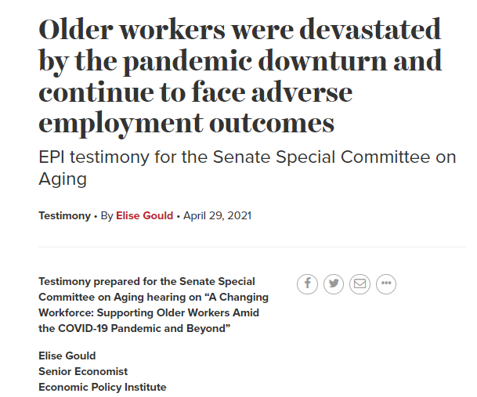
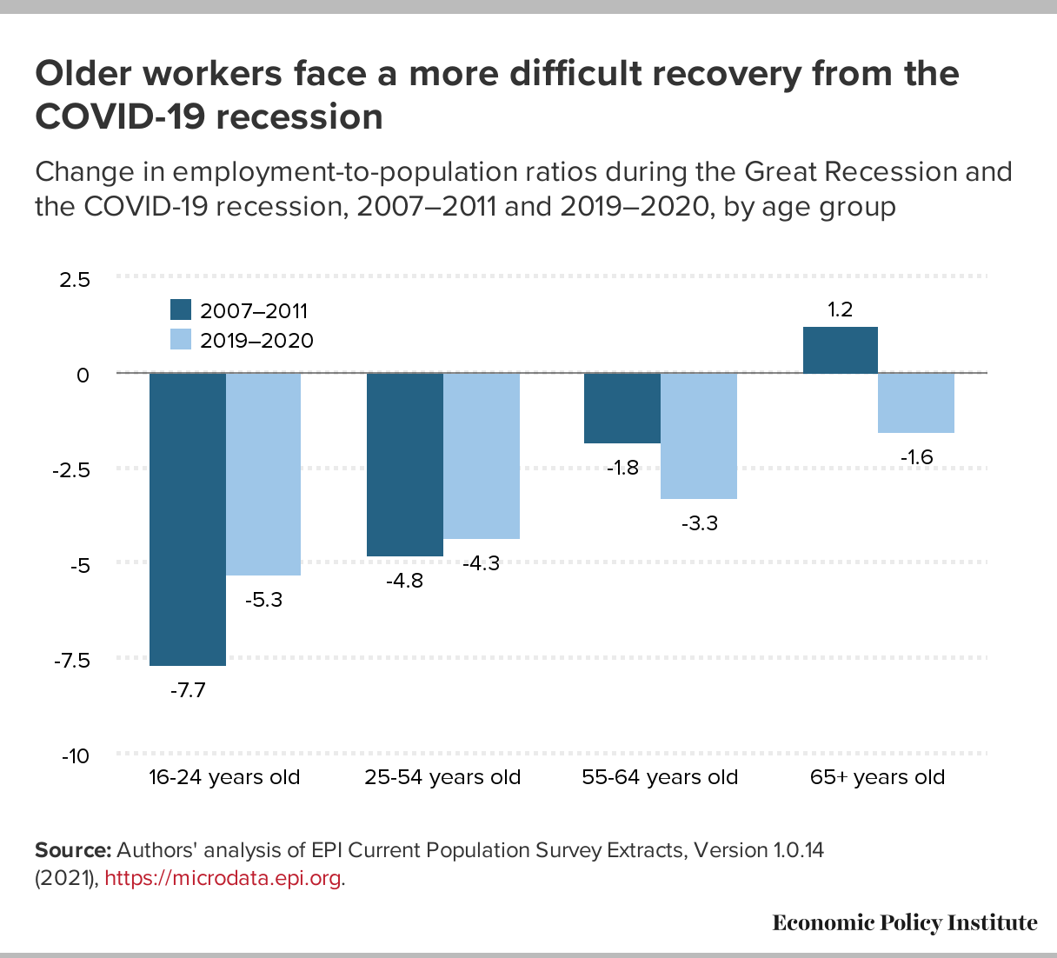
Hands-on example
Notes:
For the hands on portion we will be writing an R script that demonstrates this utility and power of creating custom analysis and the role that benchmarking plays in ensuring accuracy.
In this example, we will be employing benchmarking techniques to verify the universe of workers and test a user-defined age category grouping to validate an analysis that compares employment-to-population ratios between the Great Recession and the Covid-19 Recession across age groups to contextualize the labor force conditions for older workers during the most recent recession.
We will want the analysis that we are benchmarking to ultimately produce a figure like this one. This figure comes from a testimony given by Elise Gould to the Senate Special Committee on Aging on how to better support the older workforce as the economy recovers.
This analysis helped to highlight the difficulties that older workers faced during the Covid-19 Recession relative to another contemporary recession to demonstrate to the committee the need for policy action for recovery of the older workforce

Slide 6
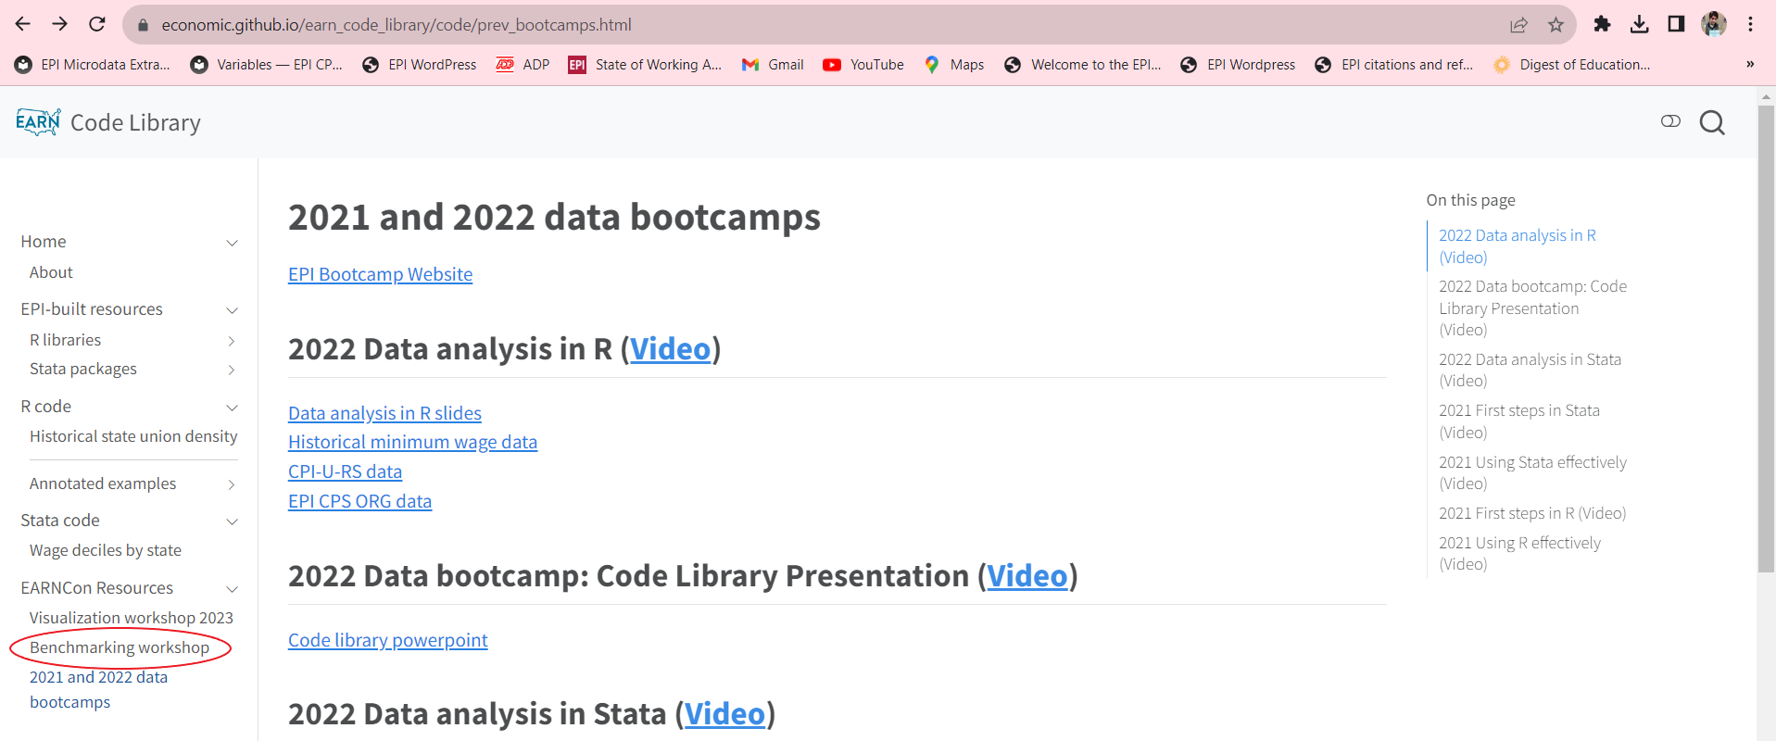
EARN code library
Notes:
Before we open R Studio I want to mention that the code is available in the EARN code library.
While these workshops are hands on and i would like everyone to follow along with me, I also want to emphasize focusing on big picture questions as we go along.
So, if it's helpful for anyone to have the final script, (which also comes with highly annotated comments), then please feel free to use that resource

Slide 7
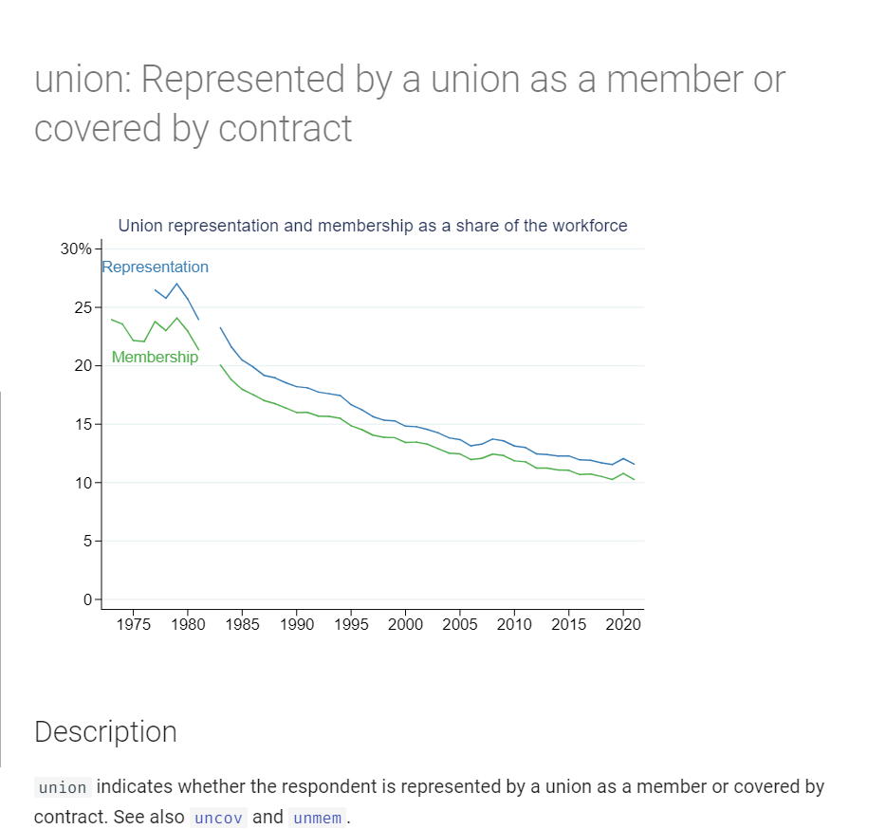
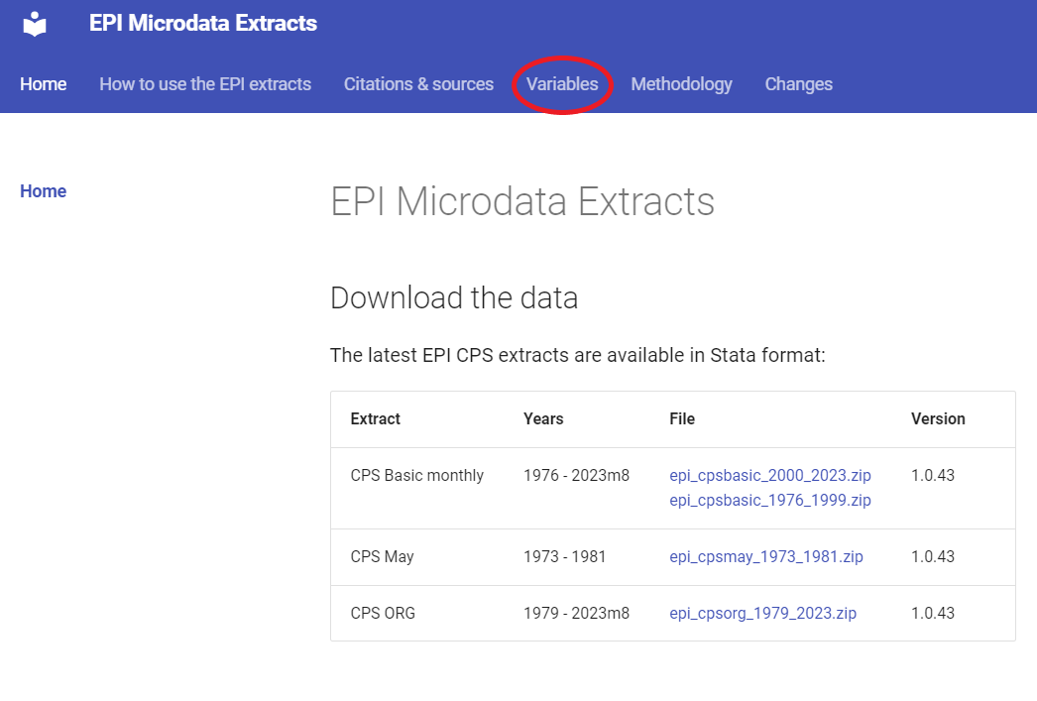
EPI Microdata Extracts

Slide 8
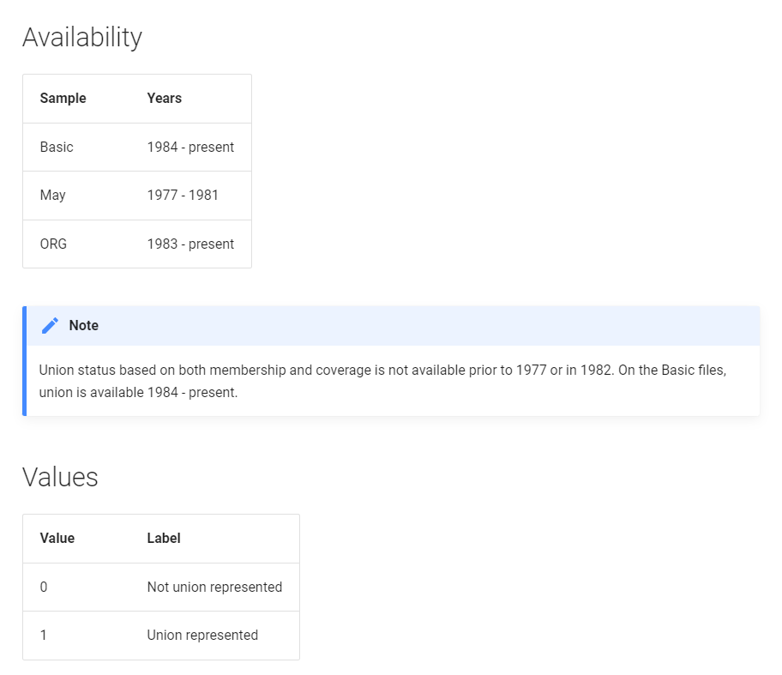
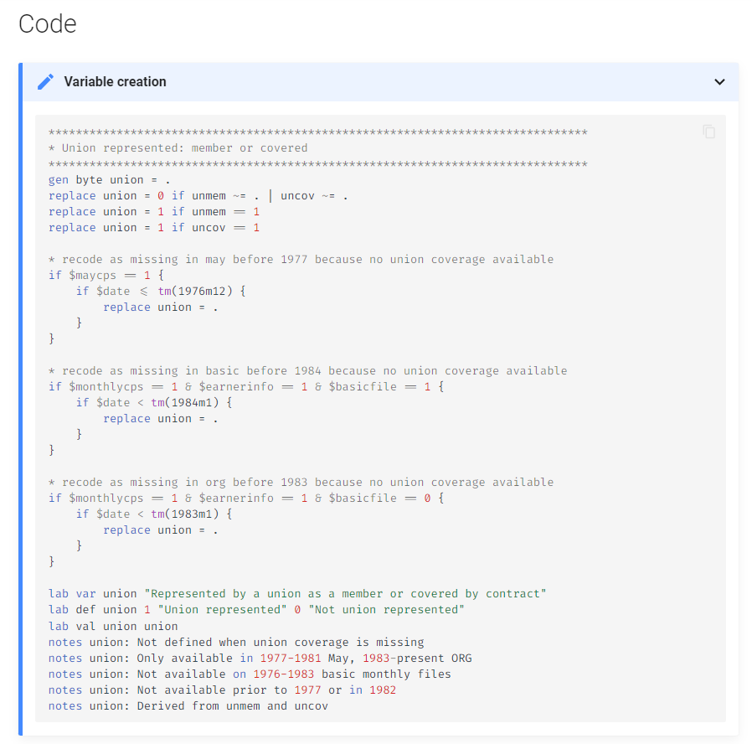
EPI microdata extracts

Slide 9
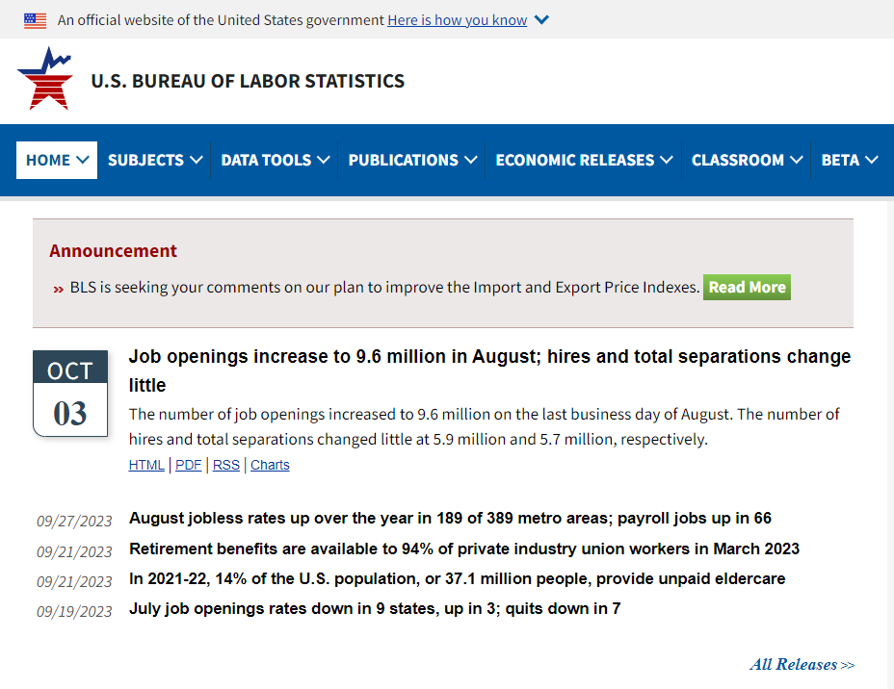
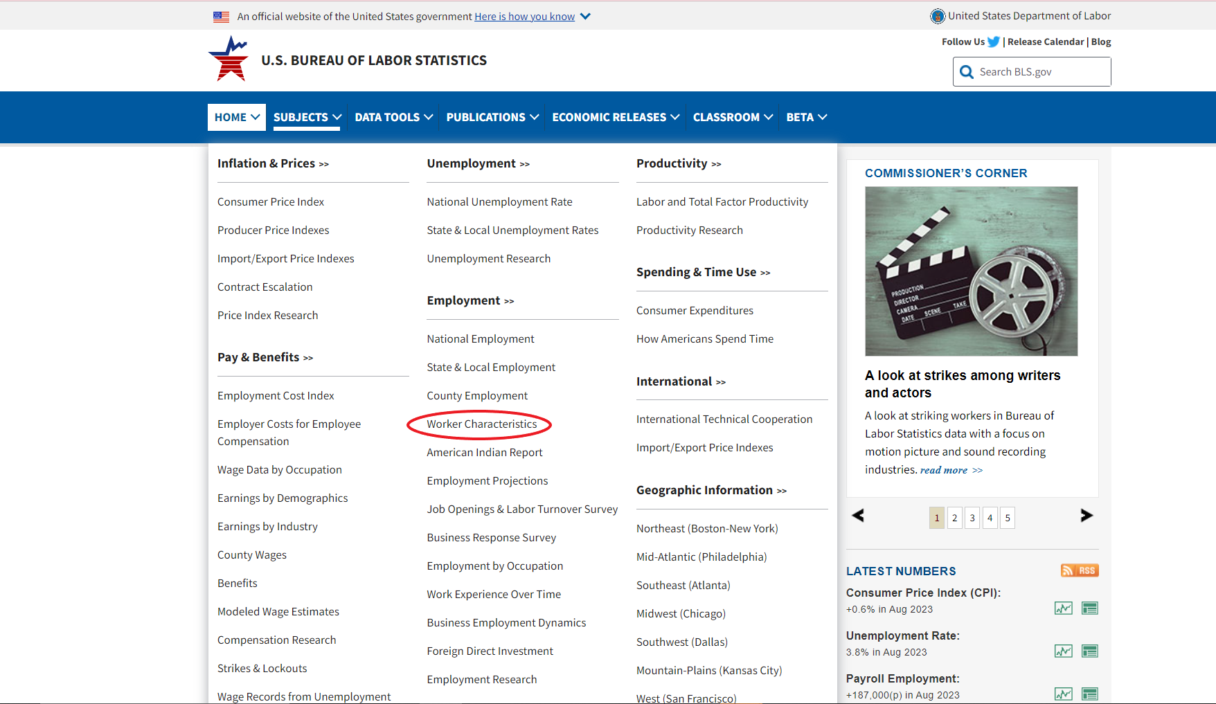
Bureau of Labor Statistics: bls.gov

Slide 10
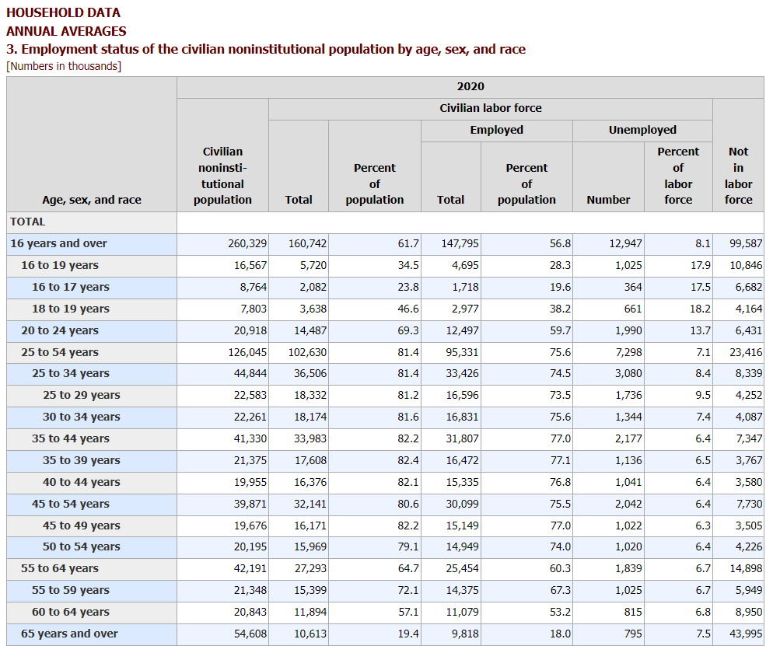
BLS CPS Table 3

Slide 11
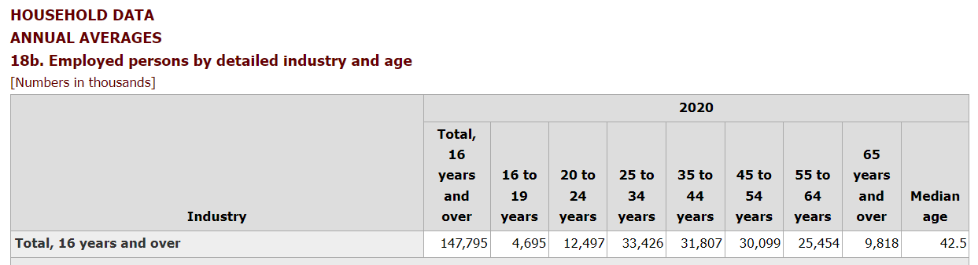
BLS CPS Table 18

